Slide 1
Windows Presentation Foundation
WPF

Slide 2
Agenda
Shapes
Transforms
Path
Animation

Slide 3
The Visual Brush
Visual Brush is an unusual brush that allows you to take the visual content of an element and use it to fill any surface.
You could copy the appearance of a button in a window to a region somewhere else in that same window.
However, the button copy won’t be clickable or interactive in any way. It’s simply a copy of how your element looks.

Slide 4
Data Binding
Binding to elements
Using Binding.ElementName property
Binding to Objects That Aren’t Elements
It’s more common to create binding expressions that draw their data from a non-visual object.
Using Source property
Binding to Database
Notes:
<Window.Resources>
<FontFamily x:Key="CustomFont">Calibri</FontFamily>
</Window.Resources>
And here’s a TextBlock that binds to this resource:
<TextBlock Text="{Binding Source={StaticResource CustomFont},
Path=Source}"></TextBlock>

Slide 5
Dependency Property
Dependency properties are a completely new implementation of properties
You need dependency properties to plug into core WPF features, such as animation, data binding, and styles.
You can read and set dependency properties in code in exactly the same way as traditional .NET properties
Notes:
In all the examples you’ve seen up to this point, you’ve been using dependency properties without
realizing it. That’s because dependency properties are designed to be consumed in the same way as normal properties.
It seems odd to think of an older technology wrapping a newer one, but that’s how WPF is able to change a fundamental ingredient such as properties without disrupting the rest of the .NET world

Slide 6
Dependency Property(cont.)
Define an object that represents your property. This is an instance of the DependencyProperty class
DependencyProperty object must be static field in associated class
In order for it to become usable, you need to register your dependency property with WPF
Registration step needs to be completed before any code uses the property, so it must be performed in a static constructor for the associated class
Notes:
The information about your property needs to be available all the time, and possibly even shared among classes (as is common with WPF elements). For that reason, your DependencyProperty object must be defined as a static field in the associated class
In order for it to become usable, you need to register your dependency property with WPF. This step needs to be completed
before any code uses the property, so it must be performed in a static constructor for the associated class.

Slide 7
Dependency Property(cont.)
public class FrameworkElement: UIElement, ...
{
public static DependencyProperty MarginProperty;
...
}

Slide 8
Data Binding
data binding is a relationship that tells WPF to extract some information from a source object and use it to set a property in a target object
Binding to elements
Using Binding.ElementName property
Binding to Objects That Aren’t Elements
It’s more common to create binding expressions that draw their data from a non-visual object.
Using Source property
Binding to Database
Notes:
Binding Elements Together:
data binding is a top concern in a user interface technology like WPF.
WPF also includes a set of list controls that can handle entire collections of information and allow you to navigate through them
The data object is the information package that you plan to display in your user interface.
Binding Object not Element:
you’ve focused on adding bindings that link two elements. But in data-driven applications, it’s more common to create binding expressions that draw their data from a nonvisual object.
The only requirement is that the information you want to display must be stored in public properties.
When binding to an object that isn’t an element, you need to give up the Binding.ElementName property and use one of the following properties instead:
Source : the object that’s supplying the data
<TextBlock Text="{Binding Source={x:Static SystemFonts.IconFontFamily}, Path=Source}"></TextBlock>
<Window.Resources> <FontFamily x:Key="CustomFont">Calibri</FontFamily> </Window.Resources>
<TextBlock Text="{Binding Source={StaticResource CustomFont}, Path=Source}"></TextBlock>
RelativeSource : which allows you to base your reference on the current element
point to a source object based on its relation to the target object
<TextBlock>
<TextBlock.Text>
<Binding Path="Title">
<Binding.RelativeSource>
<RelativeSource Mode="FindAncestor" AncestorType="{x:Type Window}" />
</Binding.RelativeSource>
</Binding>
</TextBlock.Text>
</TextBlock>
DataContext :
you’ll have a number of elements that bind to the same object
If you don’t specify a source using the Source or RelativeSource property, WPF searches up the element tree, starting at the current element ‘not found Null’
useful if you need to bind several properties of the same object to different elements,
<StackPanel DataContext="{x:Static SystemFonts.IconFontFamily}">
<TextBlock Margin="5" Text="{Binding Path=Source}"></TextBlock>
<Window.Resources>
<FontFamily x:Key="CustomFont">Calibri</FontFamily>
</Window.Resources>
And here’s a TextBlock that binds to this resource:
<TextBlock Text="{Binding Source={StaticResource CustomFont},
Path=Source}"></TextBlock>

Slide 9
Binding to elements
Adding bindings that link two elements
<TextBlock
Text=“Text" Name="lblSampleText"
FontSize="{Binding ElementName=sliderFontSize,
Path=Value , Mode=TwoWay}" >
</TextBlock>
Binding Modes Enum:
OneWay
TwoWay
OneTime
OneWayToSource
Default
Notes:
Binding Expression: {Binding ElementName=name , Path=PropertyName , Mode=TwoWay}
Binding :because you’re creating an instance of the System.Windows.Data.Binding class
you need to set just two properties:
ElementName that indicates the source element
Path that indicates the property in the source element.
Why Path NOT Property:
The name Path is used instead of Property because the Path might point to a property of a property (for example, FontFamily.Source )or an indexer used by a property (for example, Content.Children[0]). You can build up a path with multiple periods to dig into a property of a property of a property, and so on.
If you want to refer to an attached property in Path u should wrap it in () Ex: Path=(Grid.Row)
Binding Modes :
OneWay : The target property is updated when the source property changes.
TwoWay : The target property is updated when the source property changes, and the source property is updated when the target property changes.
OneTime : The target property is set initially based on the source property value. However, changes are ignored from that point onward (unless the binding is set to a completely different object or you call BindingExpression.UpdateTarget()) Usually, you’ll use this mode to reduce overhead if you know the source property won’t change.
OneWayToSource : Similar to OneWay but in reverse. The source property is updated when the target property changes (which might seem a little backward), but the target property is never updated.
Default The type of binding depends on the target property. It’s either TwoWay (for user-settable properties, such as the TextBox.Text) or OneWay (for everything else). All bindings use this approach unless you specify otherwise.
Note:OneWayToSource allows you to flip the source and target by placing the expression in what would ordinarily be considered the binding source

Slide 10
Binding to Objects That Aren’t Elements
Create binding expressions that draw their data from a nonvisual object.
No More ElementName and used one from this properties instead:
Source : the object that’s supplying the data
RelativeSource :allows you to point to a source object based on its relation to the target object
DataContext :you’ll have a number of elements that bind to the same object
<TextBlock Text="{Binding Source={x:Static SystemFonts.IconFontFamily}, Path=Source}"> </TextBlock>
Notes:
<TextBlock Text="{Binding Source={StaticResource CustomFont}, Path=Source}"></TextBlock>
it’s more common to create binding expressions that draw their data from a nonvisual object. The only requirement is that the information you want to display must be stored in public properties.
Source. This is a reference that points to the source object—in other words, the object that’s supplying the data.
RelativeSource. This points to the source object using a RelativeSource object, which allows you to base your reference on the current element. This is a specialized tool that’s handy when writing control templates and data templates.
DataContext. If you don’t specify a source using the Source or RelativeSource property, WPF searches up the element tree, starting at the current element. It examines the DataContext property of each element and uses the first one that isn’t null. The DataContext property is extremely useful if you need to bind several properties of the same object to different elements, because you can set the DataContext property of a higher-level container object, rather than setting it directly on the target element.
you’ll have a number of elements that bind to the same object.
it’s cleaner and more flexible to define the binding source once using the FrameworkElement.DataContext property.
---------------------------------------------------
The RelativeSource property allows you to point to a source object based on its relation to the target object. For example, you can use RelativeSource property to bind an element to itself or to bind to a parent element that’s found an unknown number of steps up the element tree.
<TextBlock>
<TextBlock.Text>
<Binding Path="Title">
<Binding.RelativeSource>
<RelativeSource Mode="FindAncestor" AncestorType="{x:Type Window}" />
</Binding.RelativeSource>
</Binding>
</TextBlock.Text>
</TextBlock>

Slide 11
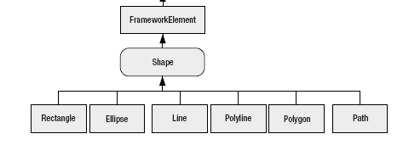
Shapes
Every shape derives from the abstract System.Windows.Shapes.Shape class.
Notes:
Line, Ellipse, and Rectangle are all straightforward, while Polyline is a connected series of
straight lines, and Polygon is a closed shape made up of a connected series of straight lines.
Finally, the Path class is an all-in-one superpower that can combine basic shapes in a single
element.

Slide 12
Shape Properties
Fill: Sets the brush object that paints the surface of the shape (everything inside its borders)
Stroke: Sets the brush object that paints the edge of the shape (its border)
StrokeThickness:
Sets the thickness of the border
Stretch:
Determines how a shape fills its available space.

Slide 13
Example
<StackPanel>
<Ellipse Fill="Yellow" Stroke="Blue"
Height="50" Width="100" Margin="5“
HorizontalAlignment="Left">
</Ellipse>
<Rectangle Fill="Yellow" Stroke="Blue"
Height="50" Width="100" Margin="5“
HorizontalAlignment="Left">
</Rectangle>
</StackPanel>
Notes:
Note :
In shapes we can apply flowLayout as shown in the above example or we can use the coordinates as shown in demos

Slide 14
Shapes
WPF shapes use the same layout system as any other element
Some layout containers aren’t as appropriate. For example, the StackPanel,DockPanel, and WrapPanel often aren’t what you want because they’re designed to separate elements
Canvas forces you to specify the coordinates of each shape using the attached Left, Top, Right, or Bottom properties. This gives you complete control over how shapes overlap

Slide 15
Path Class
The Path class includes a single property, named Data, that accepts a Geometry object that defines the shape (or shapes) the path includes.
You can’t create a Geometry object directly because it’s an abstract class
Geometry Classes
LineGeometry
RectangleGeometry
EllipseGeometry
GeometryGroup
Notes:
The GeometryGroup class is an invaluable tool for building complex shapes out of the basic
primitives (rectangle, ellipse, and line). However, it has obvious limitations. However, it’s difficult to get the result you want if the shape borders intersect one another. there’s another tool that you can use: the CombinedGeometry class. It’s tailor-made for combining shapes that overlap, and where neither shape contains the other completely.

Slide 16
Transforms
An object that alters the way a shape or element is drawn by secretly shifting the coordinate system it uses
Transform Classes
TranslateTransform
This transform is useful if you want to draw the same shape in different places using properties X,Y
RotateTransform
The shapes you draw normally are turned around a center point you choose,using Angle, CenterX, CenterY property
ScaleTransform
Shapes are drawn smaller or larger using ScaleX, ScaleY
Notes:
When you rotate a shape in this way, you rotate it about the shape’s origin (the top-left corner) If we want to rotate shape from different point

Slide 17
Transforming Shapes
To transform a shape, you assign the RenderTransform property to the transform object you want to use.
<Rectangle Width="80" Height="10" Stroke="Blue" Fill="Yellow“ Canvas.Left="100" Canvas.Top="100">
<Rectangle.RenderTransform>
<RotateTransform Angle="25“ CenterX="25" CenterY="5" />
</Rectangle.RenderTransform>
</Rectangle>
Notes:
There’s a clear limitation to using the CenterX and CenterY properties of the
RotateTransform. These properties are defined using absolute coordinates, which means
you need to know the exact center point of your content. If you’re displaying dynamic content
(for example, pictures of varying dimensions or elements that can be resized), this introduces
a problem

Slide 18
RenderTransformOrigin property
<Rectangle Width="80" Height="10" Stroke="Blue" Fill="Yellow"
Canvas.Left="100" Canvas.Top="100" RenderTransformOrigin="0.5,0.5">
<Rectangle.RenderTransform>
<RotateTransform Angle="25" />
</Rectangle.RenderTransform>
</Rectangle>
Notes:
There’s a clear limitation to using the CenterX and CenterY properties of the
RotateTransform. These properties are defined using absolute coordinates, which means
you need to know the exact center point of your content. If you’re displaying dynamic content
(for example, pictures of varying dimensions or elements that can be resized), this introduces
a problem.
RenderTransformOrigin property,
which is supported by all shapes. This property sets the center point using a proportional
coordinate system that stretches from 0 to 1 in both dimensions. In other words, the point
(0, 0) is designated as the top-left corner and (1, 1) is the bottom-right corner.

Slide 19
CombinedGeometry
It’s tailor-made for combining shapes that overlap, and where neither shape contains the other completely.
Values from the GeometryCombineMode Enumeration
Union: Creates a shape that includes all the areas of the two geometries.
Intersect: Creates a shape that contains the area that’s shared between the two geometries.
Xor: Creates a shape that contains the area that isn’t shared between the two geometries. In other words, it’s as if the shapes are combined (using a Union) and then the shared part (the Intersect) is removed.
Exclude: Creates a shape that includes all the area from the first geometry, not including the area that’s in the second geometry.
Notes:
Xor
kol al shakl ma 3ada al taka6o3 ally been al 2 shapes
Exclude
Al shakl al awal ma3ada al goz2 ally beno we been al shape al tany taka6o3

Slide 20
ViewBox
The only limitation to using the Canvas is that your graphics won’t be able to resize themselves to fit larger or smaller windows(buttons which don’t change size in these situations)
The Viewbox is a simple class that derives from Decorator.
It accepts a single child, which it stretches or shrinks to fit the available space

Slide 21
Event Routing
Event routing allows an event to originate in one element but can be raised by another one
Event routing gives you the flexibility to write tight, well-organized code that handles events in the most convenient place
WPF event model is quite similar to the WPF property model

Slide 22
Event Routing(cont.)
As with dependency properties , routed events are represented by static fields
Registered in a static constructor
Wrapped by a standard .NET event definition
public abstract class ButtonBase : ContentControl, ...
{
// The event definition.
public static RoutedEvent ClickEvent;
// The event registration.
static ButtonBase()
{
ButtonBase.ClickEvent = EventManager.RegisterRoutedEvent ("Click", RoutingStrategy.Bubble,typeof(RoutedEventHandler),typeof(ButtonBase));
}
}
Notes:
While dependency properties are registered with the DependencyProperty.Register()
method, routed events are registered with the EventManager.RegisterRoutedEvent() method.
When registering an event, you need to specify the name of the event, the type of routine
(more on that later), the delegate that defines the syntax of the event handler (in this example,
RoutedEventHandler), and the class that owns the event (in this example, ButtonBase).

Slide 23
Routed Event Example
UIElement.MouseUpEvent=
Mouse.MouseUpEvent.AddOwner(typeof(UIElement));
UIElement class
ContentElement class
MouseUp Event
System.Windows.Input.Mouse
Notes:
UIElement Class and ContentElement Class are using MouseUp Event which is defined in System.Windows.Input.Mouse
Event routing allows an event to originate in one element but be raised by another one.
The above example shows that the MouseUp event originates in System.Windows.Input.Mouse but it’ll be raised in any UIElement object or ContentElement object.

Slide 24
Routed Event Signature
private void img_MouseUp(object sender, MouseButtonEventArgs e)
{
…………
}
Notes:
All WPF events use the familiar .NET convention for event signatures. That first parameter
of every event handler provides a reference to the object that fired the event (the sender). The
second parameter is an EventArgs object that bundles together any additional details that
might be important. For example, the MouseUp event provides a MouseEventArgs object that
indicates what mouse buttons were pressed.
In WPF, if an event doesn’t need to send any additional details, it uses the RoutedEvent-
Args class, which includes some details about how the event was routed

Slide 25
Attaching an Event Handler
<Image Source="happyface.jpg" Stretch="None“ Name="img“ MouseUp="img_MouseUp"/>
Equivalent
img.MouseUp += new MouseButtonEventHandler(img_MouseUp);

Slide 26
Animations
Animation allows you to create truly dynamic user interfaces.
Animations are a core part of the WPF model
You don’t need to use timers and event handling code to put them into action.
An animation is thought of as a series of frames
To perform the animation, these frames are shown one after the other, like a stop-motion video.
WPF animation is simply a way to modify the value of a
dependency property over an interval of time.
The secret to creating the right animation is determining what properties you need to modify.
Notes:
For example, to make a button that grows and shrinks, you can modify its Width property
in an animation. To make it shimmer, you could change the properties of the LinearGradient-
Brush that it uses for its background.

Slide 27
The Animation Classes
There are actually two types of animations :
Animations that vary a property incrementally between the starting and finishing values (a process called linear interpolation-Smoothing value)
Animations that abruptly change a property from one value to another.(Key Frames)
System.Windows.Media.Animation namespace support 42 classes used for animation
Notes:
DoubleAnimation and ColorAnimation are examples of the first category; they use interpolation to smoothly change the value.
Most common animation technique is linear interpolation
For example, if you set a starting value of 1 and an ending value of 10, your property might be rapidly changed from 1 to 1.1, 1.2, 1.3, and so on, until the value reaches 10.
The standard frame rate WPF uses is 60 frames per second.
the most common layout container for “animatable”
content is the Canvas, because it makes it easy to move content around (with possible overlap)
and resize it. Canvas is also the most lightweight layout container, because no extra
layout work is needed when a property like Width is changed.

Slide 28
Button Animation Example
DoubleAnimation widthAnimation = new DoubleAnimation();
widthAnimation.From = 160;
widthAnimation.To = this.Width - 30;
widthAnimation.Duration =TimeSpan.FromSeconds(5);
cmdGrow.BeginAnimation(Button.WidthProperty, widthAnimation);

Slide 29
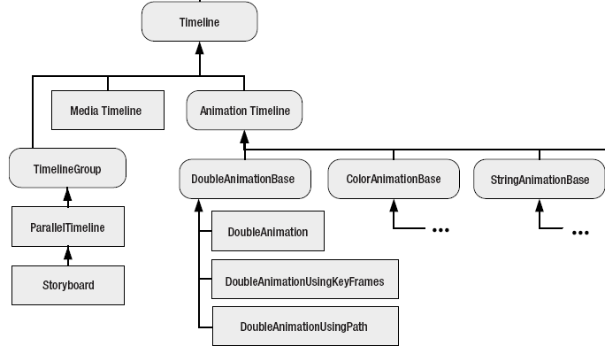
Timeline
Notes:
MediaTimeline is used when playing audio or video files
AnimationTimeline is used for the property-based animation system you’ve considered so
far.
TimelineGroup allows you to synchronize timelines and control their playback.

Slide 30
How can we use XAML in Animation?
Storyboard
It’s the XAML equivalent of the BeginAnimation() method. It allows you to direct an animation to the right element and property
<Storyboard
TargetName="cmdGrow“
TargetProperty="Width">
<DoubleAnimation
From="160" To="300“
Duration="0:0:5">
</DoubleAnimation>
</Storyboard>

Slide 31
An event trigger
It responds to event (such as the Click event of a button) and controls the storyboard

Slide 32
Animations
Animation allows you to create truly dynamic user interfaces.
Animations are a core part of the WPF model
You don’t need to use timers and event handling code to put them into action.
An animation is thought of as a series of frames
To perform the animation, these frames are shown one after the other, like a stop-motion video.
WPF animation is simply a way to modify the value of a
dependency property over an interval of time.
The secret to creating the right animation is determining what properties you need to modify.
Notes:
Timer based animation:
It paints pixels, not controls. (GDI+)
It assumes a single animation.
Complex animations require exponentially more complex code.
WPF includes a higher-level model that allows you to focus on defining your animations, without worrying about the way they’re rendered.
Property based animation:
WPF used diff. model , modify property value over an interval of time , The secret to creating the right animation is determining what properties you need to modify
you can create a wide range of animated effects using common properties that every element supports
property-based animation is a great way to add dynamic effects to otherwise ordinary Windows applications.
Animation basic:
To animate a property (in other words, change its value in a time-dependent way), you need to have an animation class that supports its data type.
every animation acts on a single dependency property
Button.Width property uses the double data type. To animate it, you use the DoubleAnimation class.
Button.Padding uses the Thickness structure, so it requires the ThicknessAnimation class.
SolidColorBrush (using the ColorAnimation class) or
Offset property of a GradientStop in a LinearGradientBrush (using the DoubleAnimation class).
you can animate a dependency property that doesn’t have a corresponding animation class by creating your own animation class for that data type.
For example, to make a button that grows and shrinks, you can modify its Width property
in an animation. To make it shimmer, you could change the properties of the LinearGradient-
Brush that it uses for its background.
Animation Lifetime:
Technically, WPF animations are temporary, which means they don’t actually change the value of the underlying property. While an animation is active, it simply overrides the property value.

Slide 33
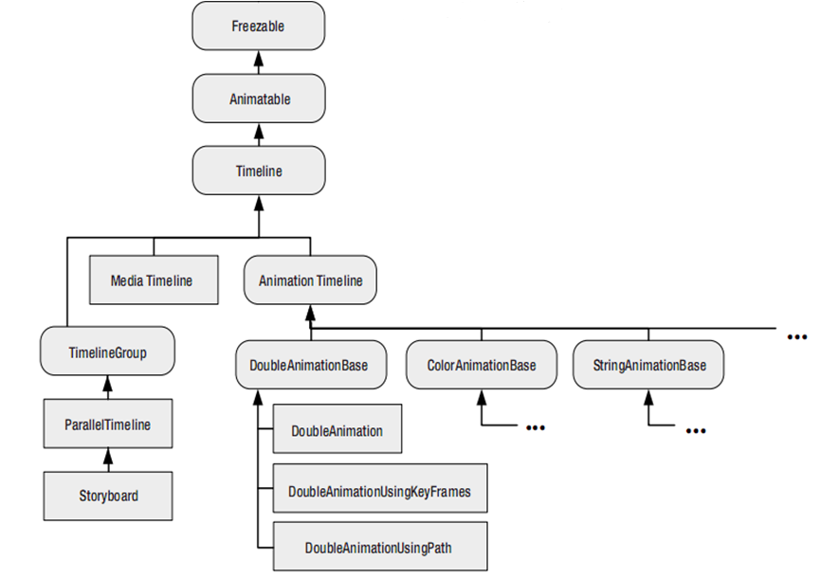
The Animation Classes

Slide 34
The Animation Classes
System.Windows.Media.Animation namespace support 42 classes used for animation
Seventeen TypeNameAnimation classes, which use interpolation
Twenty-two TypeNameAnimationUsingKeyFrames classes, which use key frame animation
Three TypeNameAnimationUsingPath classes, which use path-based animation
Every one of these animation classes derives from an abstract TypeNameAnimationBase class
Notes:
The standard frame rate WPF uses is 60 frames per second.
storyboard—to connect the animation to the appropriate property.

Slide 35
Button Animation Example
DoubleAnimation widthAnimation
= new DoubleAnimation();
widthAnimation.From = 160;
widthAnimation.To = 300; //this.Width - 30;
widthAnimation.Duration =TimeSpan.FromSeconds(5);
widthAnimation.AutoReverse = true;
BtnName.BeginAnimation
(Button.WidthProperty, widthAnimation);
//Create Animation object
//Configuration
//Connect animation With element and property
Notes:
If you start a second animation, the first one is automatically discarded. “in the same Property”
Ex :MouseEnter and MouseLeave
the most common layout container for “animatable” content is the Canvas, because it makes it easy to move content around (with possible overlap) and resize it. The Canvas is also the most lightweight layout container, because no extra layout work is needed when a property like Width is changed.
“in Animation Element“ You do this by setting the AutoReverse property to true. To reverse animation to initial value ”More smoothly than FillBehavior”
FillBehavior is set to HoldEnd, Stop → defualt HoldEnd

Slide 37
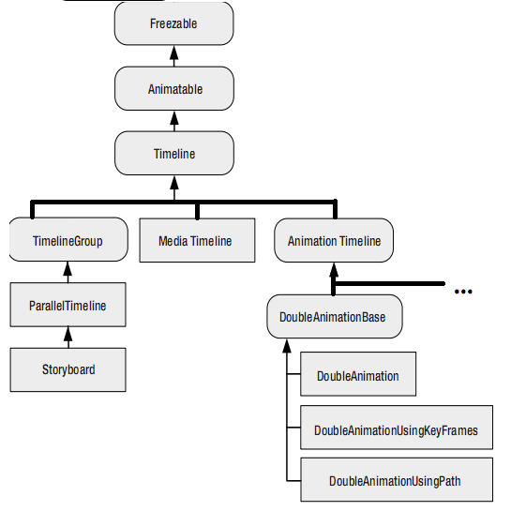
Timeline
Notes:
The class hierarchy includes three main branches that derive from the abstract Timeline class.
MediaTimeline is used when playing audio or video files
AnimationTimeline is used for the property-based animation system you’ve considered so far.
TimelineGroup allows you to synchronize timelines and control their playback.
The first useful members appear in the Timeline class, which defines the Duration property you’ve already considered and a few more.
Timeline Properties :
BeginTime Sets a delay that will be added before the animation starts (as a TimeSpan). This delay is added to the total time so a five-second animation with a five-second delay takes ten seconds. BeginTime is useful when synchronizing different animations that start at the same time but should apply their effects in sequence.
Duration Sets the length of time the animation runs, from start to finish, as a Duration object.
SpeedRatio Increases or decreases the speed of the animation. Ordinarily, SpeedRatio is 1
AccelerationRatio and DecelerationRatio : Makes an animation nonlinear, so it starts off slow and then speeds up (by increasing the AccelerationRatio) or slows down at the end (by increasing the DecelerationRatio). Both values are set from 0 to 1 and begin at 0. Furthermore, the total of both values cannot exceed 1.
AutoReverse : If true, the animation will play out in reverse once it’s complete, reverting to the original value.
FillBehavior : Determines what happens when the animation ends (FillBehavior.HoldEnd / FillBehavior.Stop)
RepeatBehavior : Allows you to repeat an animation a specific number of times or for a specific time interval. (Time /Count/ Forever ) The RepeatBehavior object that you use to set this property determines the exact behavior. the total time is unchanged.
Tip You can use RepeatBehavior to perform just part of an animation. To do so, use a fractional number of repetitions, or use a TimeSpan that’s less than the duration.

Slide 38
Timeline Properties
BeginTime :
Sets a delay that will be added before the animation starts (as a TimeSpan)
Duration :
Sets the length of time the animation runs
SpeedRatio
Increases or decreases the speed of the animation
AccelerationRatio andDecelerationRatio
Makes an animation nonlinear (slows)
AutoReverse
If true, the animation will reverting to the original value.
FillBehavior
Determines what happens when the animation ends
RepeatBehavior
Allows you to repeat an animation
Notes:
BeginTime Sets a delay that will be added before the animation starts (as a TimeSpan). This delay is added to the total time, so a five-second animation with a five-second delay takes ten seconds. BeginTime is useful when synchronizing different animations that start at the same time but should apply their effects in sequence.
Duration Sets the length of time the animation runs, from start to finish, as a Duration object.
SpeedRatio Increases or decreases the speed of the animation. Ordinarily, SpeedRatio is 1. If you increase it, the animation completes more quickly (for example, a SpeedRatio of 5 completes five times faster). If you decrease it, the animation is slowed down (for example, a SpeedRatio of 0.5 takes twice as long). You can change the Duration of your animation for an equivalent result. The SpeedRatio is not taken into account when applying the BeginTime delay.
AccelerationRatio and DecelerationRatio Makes an animation nonlinear, so it starts off slow and then speeds up (by increasing the AccelerationRatio) or slows down at the end (by increasing the DecelerationRatio). Both values are set from 0 to 1 and begin at 0. Furthermore, the total of both values cannot exceed 1.
AutoReverse If true, the animation will play out in reverse once it’s complete, reverting to the original value. This also doubles the time the animation takes. If you’ve increased the SpeedRatio, it applies to both the initial playback of the animation and the reversal. The BeginTime applies only to the very beginning of the animation—it doesn’t delay the reversal.
FillBehavior Determines what happens when the animation ends. Usually, it keeps the property fixed at the ending value (FillBehavior.HoldEnd), but you can also choose to return it to its original value (FillBehavior.Stop).
RepeatBehavior Allows you to repeat an animation a specific number of times or for a specific time interval. The RepeatBehavior object that you use to set this property determines the exact behavior.

Slide 39
Storyboards
WPF animations are represented by a group of animation classes.
To Declare any animation:
Storyboard:
It’s the XAML equivalent of the BeginAnimation() method.
It allows you to direct an animation to the right element and property
Event Trigger: It responds to a property change or event
Notes:
WPF animations are represented by a group of animation classes. You set the relevant information, such as the starting value, ending value, and duration, using a handful of properties. This obviously makes them a great fit for XAML. What’s less clear is how you wire an animation up to a particular element and property and how you trigger it at the right time.
* It turns out that two ingredients are at work in any declarative animation:
A storyboard. It’s the XAML equivalent of the BeginAnimation() method. It allows you to direct an animation to the right element and property
An event trigger. It responds to a property change or event (such as the Click event of a button) and controls the storyboard. For example, to start an animation, the event trigger must begin the storyboard.

Slide 40
Storyboard
It’s the XAML equivalent of the BeginAnimation() method. It allows you to direct an animation to the right element and property
A storyboard is an enhanced timeline
You can use it to group multiple animations
control the playback of animation
its ability to point to a specific property and specific element using the TargetProperty and TargetName properties.
Defining a storyboard is the first step to creating an animation. To actually put this storyboard into action, you need an event trigger
the storyboard bridges the gap between your animation and the property you want to animate
Notes:
StoryBoard:
StoryBoards enhanced timeline.
You can use it to group multiple animations,
has the ability to control the playback of animation—pausing it, stopping it, and changing its position
Storyboard class is its ability to point to a specific property and specific element using the TargetProperty and TargetName properties.
the storyboard bridges the gap between your animation and the property you want to animate
Both TargetName and TargetProperty are attached properties from storyboard to animation. it allows you to put several animations in the same storyboard but allow each animation to act on a different element and property
Defining a storyboard is the first step to creating an animation. To actually put this storyboard into action, you need an event trigger
event trigger :

Slide 41
How can we use XAML in Animation?
<Storyboard
TargetName="cmdGrow“
TargetProperty="Width">
<DoubleAnimation
From="160" To="300“
Duration="0:0:5">
</DoubleAnimation>
</Storyboard>
Notes:
Overlapping Animation:
when a second animation is applied to a property that is already being animated. You do this
using the BeginStoryboard.HandoffBehavior property(snapshot-and-replace , Compose).
<EventTrigger RoutedEvent="ListBoxItem.MouseLeave">
<EventTrigger.Actions>
<BeginStoryboard HandoffBehavior="Compose">
<Storyboard>…</EventTrigger>
Synchronized Animations
The Storyboard class derives indirectly from TimelineGroup, which gives it the ability to hold more than one animation by using TargetName and TargetProperty as attached Property in animation from StoryBoard
Because the animations are grouped into one storyboard, they increment the button’s dimensions in unison, which gives a more synchronized effect than simply calling BeginAnimation() multiple times in your code.
<EventTrigger RoutedEvent="Button.Click">
<EventTrigger.Actions>
<BeginStoryboard>
<Storyboard>
<DoubleAnimation Storyboard.TargetProperty="Width“ To="300" Duration="0:0:5"></DoubleAnimation>
<DoubleAnimation Storyboard.TargetProperty="Height” To="300" Duration="0:0:5"></DoubleAnimation>
</Storyboard>
</BeginStoryboard>
</EventTrigger.Actions>
</EventTrigger>
Because Storyboard derives from Timeline, you can use all the properties that were described in Table 15-1 to configure its speed, use acceleration or deceleration, introduce a delay time, and so on. These properties will affect all the contained animations, and they’re cumulative. For example, if you set the Storyboard.SpeedRatio to 2 and the DoubleAnimation.SpeedRatio to 2, that animation will run four times faster than usual.
Controlling Playback
you’ve been using one action in your event triggers—the BeginStoryboard action that launches an animation. However, you can use several other actions to control a storyboard once it’s created
PauseStoryboard
ResumeStoryboard
StopStoryboard
RemoveStoryboard
you must define all the triggers in one Triggers collection

Slide 42
Links
-Material Design In XAML
http://materialdesigninxaml.net/
-Game Tutorial
https://www.mooict.com/wpf-c-tutorial-create-a-space-invaders-game-in-visual-studio/
-Resource vs. EmbeddedResource (build action)
https://ikriv.com/blog/?p=1530

